Slide 1

Bank Loan Customer Profile and Repayment Behavior Analysis
Unlocking data-driven insights to revolutionize banking decisions.

Slide 2


Project Objective
Analyze Loan Data
Identify Risk Patterns
Understand credit scores, loan status, and repayment behavior.
Distinguish between good and bad borrowers to mitigate risks.
Provide Insights
Deliver data-driven visualizations for informed decision-making.

Slide 3

Tools & Technologies: Python
Python was essential for data cleaning, preprocessing, and Exploratory Data Analysis (EDA). It helped handle missing values, outliers, and understand key features like credit score, income, and loan amount.
Data Cleaning & Preprocessing
Exploratory Data Analysis (EDA)
Feature Understanding
Key libraries used include pandas, numpy, matplotlib, and seaborn for robust analysis.

Slide 4

Tools & Technologies: MySQL
MySQL was utilized for storing structured banking data and executing SQL queries for in-depth analysis. This involved filtering, aggregating, and joining tables to prepare clean datasets.
Structured Data Storage
SQL Querying for Analysis
Data Aggregation & Filtering
Concepts like SELECT, WHERE, GROUP BY, ORDER BY, and aggregate functions were crucial.

Slide 5

Tools & Technologies: Power BI
Power BI enabled the creation of interactive dashboards for visual analysis of loan performance. It facilitated trend identification and supported strategic decision-making.
Interactive Dashboards
Visual Analysis
Trend Identification
Features like KPI cards, bar charts, pie charts, filters, and slicers were leveraged for customer segmentation.

Slide 6


Project Workflow: End-to-End
Data Collection
Raw banking data imported from CSV/SQL.
Data Cleaning
Duplicates removed, missing values handled, data types corrected.
Data Storage
Cleaned data stored in MySQL tables.
Data Analysis
Credit score vs. repayment, income vs. approval, default rates.
Visualization
Dashboards created in Power BI.

Slide 7





Key Insights & Business Impact
Higher Credit Scores
Loan Categories
Correlate with better repayment rates.
Certain types show higher default risk.
Income Level
Minimize Risk
Influences loan approval and repayment.
Improve loan approval strategies.

Slide 8
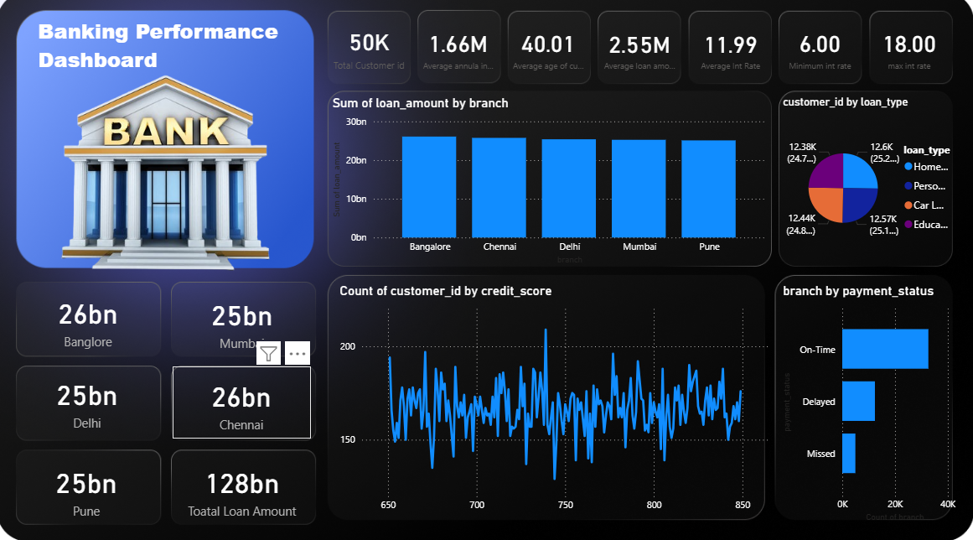
Dashboard Highlights
The Power BI dashboard provides a comprehensive overview of banking performance.
It visualizes loan status, credit score distribution, and customer risk segmentation with interactive filters.

Slide 9

Project Conclusion
1
2
3
Data Analysis Skills
Tool Proficiency
Business Insights
Demonstrates end-to-end data analysis capabilities.
Strong understanding of SQL, Python, and Power BI.
Ability to convert raw data into meaningful business insights.

Slide 10





Future Enhancements
ML for Prediction
Integrate machine learning for loan default prediction.
Automate Updates
Automate data updates for real-time insights.
Behavioral Features
Include more customer behavioral features.
Improve Interactivity
Enhance dashboard interactivity for deeper analysis.

